Slide 1
An asset based community solution to tackling secondhand smoke
June 2015

Slide 2
Setting the scene….
Activmob CIC and the Tobacco Control Collaboration Centre were commissioned by Kent County Council Public Health to work with a local community to co-design a way to protect children aged 0-5 from second hand smoke.
Undertaken in North Kent
3 phases
Insight gathering
Co-design
Pilot and evaluation

Slide 3
Phase 1: Insight gathering
What did we find?

Slide 4
The answer is obvious!!
A ideas to action workshop was held to feedback ideas, parents involved suggested he following:
“its obvious, we smoke most round our children in our cars and homes…. Can you make something to help us stop!”
2. Training for trusted people to talk about the topic, and support the parents in using the kit

Slide 5
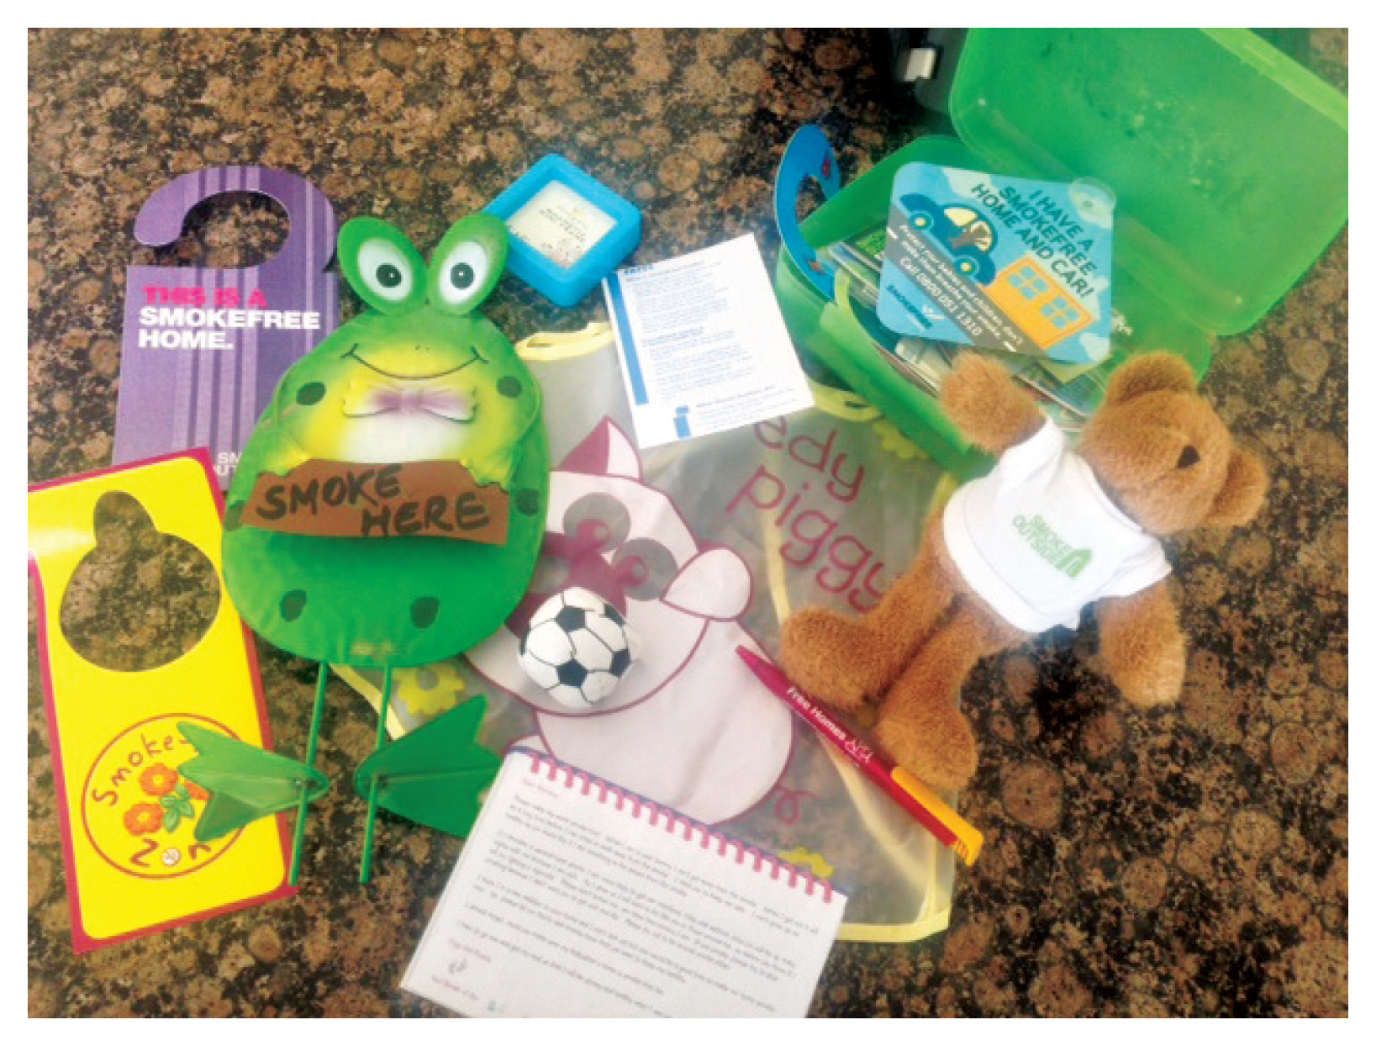
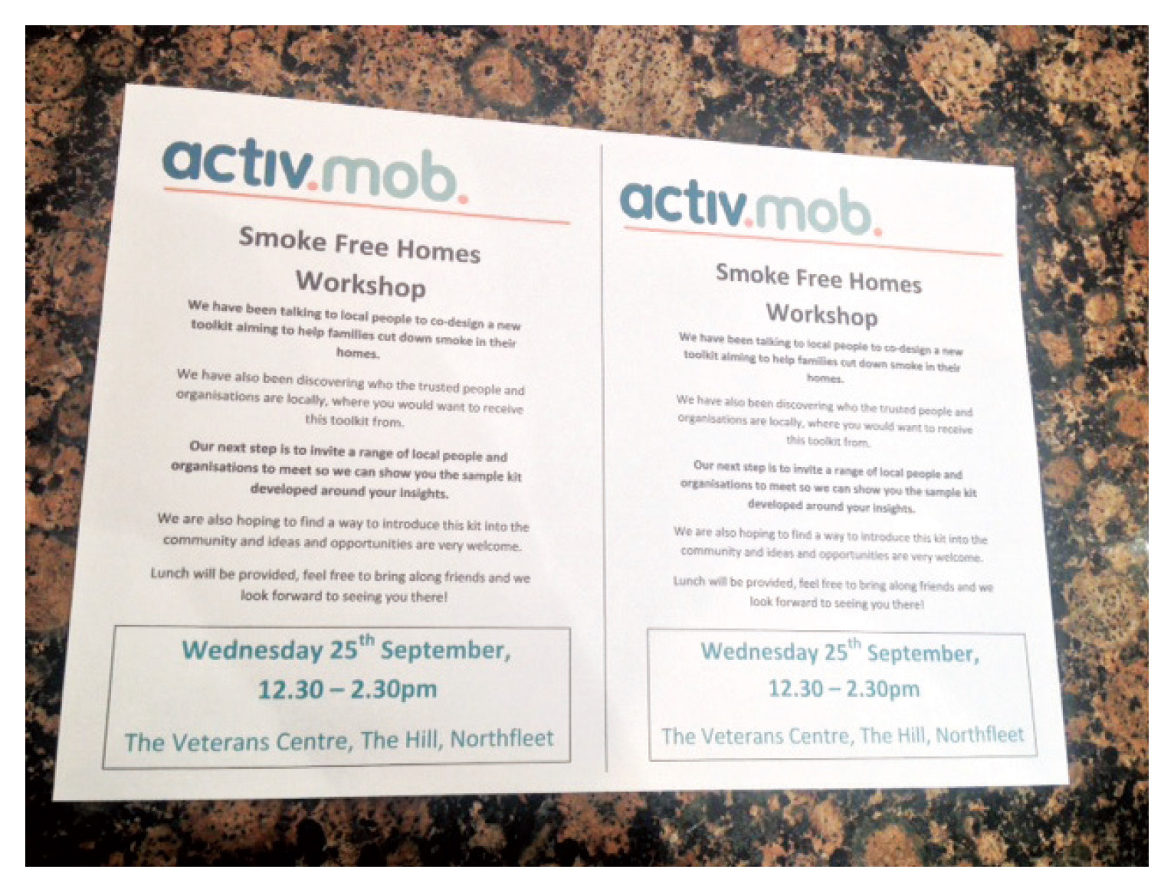
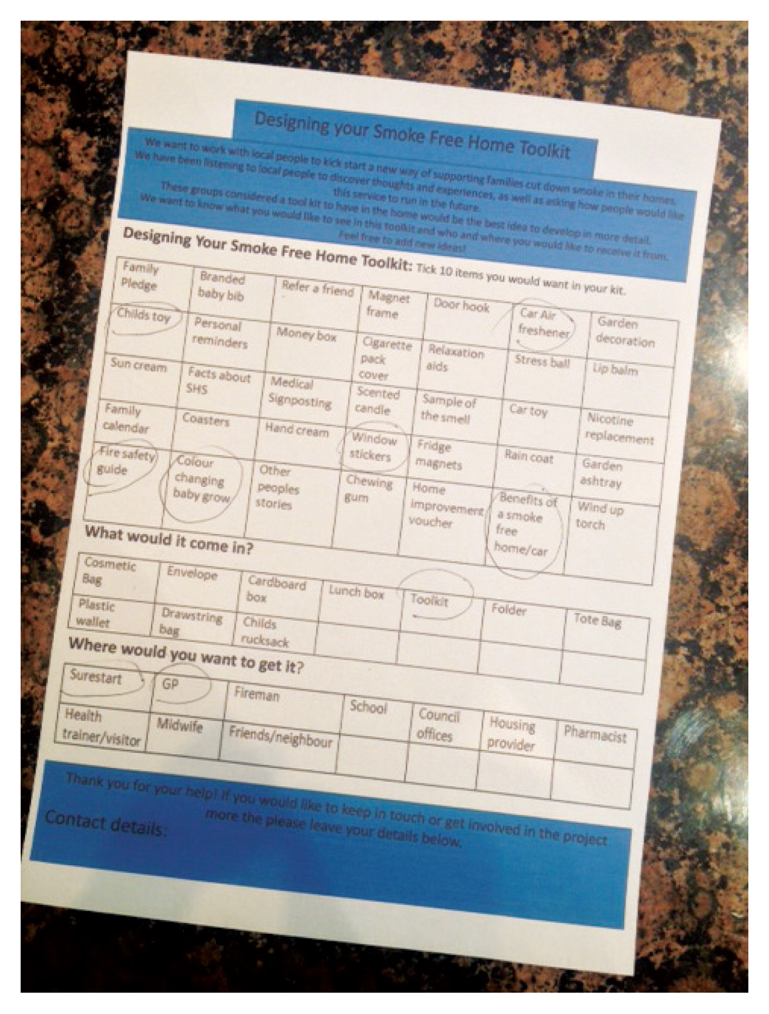
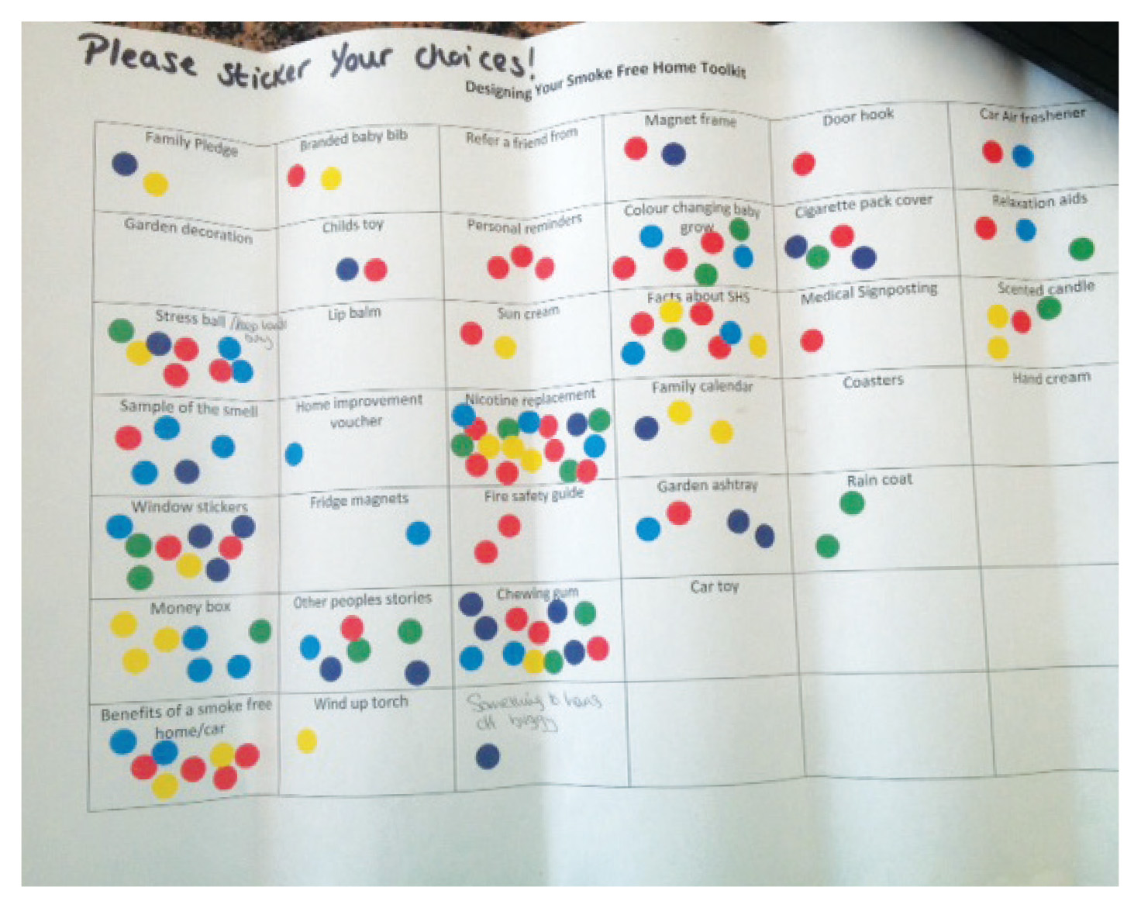
Phase 2: Co-design
This process had to work for the community-
expect to change your plans!
This included:
Identifying and designing the kit
Exploring branding
Good and bad conversations
Engagement split in four phases
Messaging and knowledge
What could it be, feel like, do?
What’s out there already?
What should be in out kit?

Slide 6
What did we learn?
About the kit?
Items had to have an everyday useful purpose
Honest facts
Distractions or things to do were important
Must include NRT if “its to work here”
Definitions of a smoke free home must be clear
And about the branding and messages?
Not about stopping smoking
The language has got to be right!
Trusted people and places
‘I trust the people at the surestart… they have known me and my baby for a long time’

Slide 7
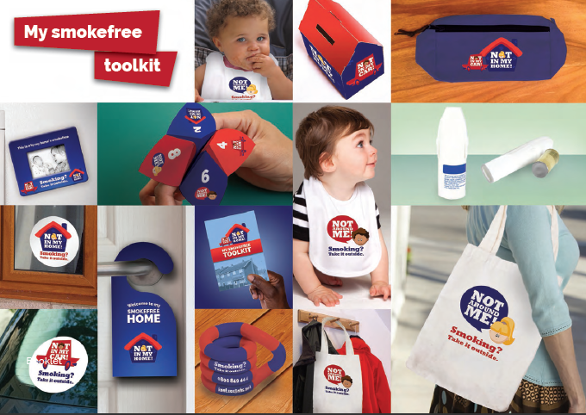
SMOKE FREE HOMES
Co-designing a solution

Slide 8
Phase 3: The pilot
Training
delivered by TCCC
Included Motivational interviewing and challenging conversations
Well received- transferable skills
150 packs given out to parents across the Northfleet and Gravesend area
Evaluation
As part of the training, instruction on how the evaluation would be undertaken
Conversations held at start, 1 month and 3 months

Slide 9
SMOKE FREE HOMES
Outcomes
81% were now smoke free in their home and car
100% of parents noticed significant positive change within a month in their children and in their homes
50% increase in levels of confidence of the front line workers from training, support and coaching
“my son is not wheezing anymore”
“I cant believe he has not been off school in the past month”
“My house and car really smell better, the house looks cleaner and the net curtains are no longer yellow….. friends and family have commented too”

Slide 10
Key learning from all involved!
The approach must be asset based – working with communities, understanding what they value locally and working with those assets (both formal and informal) to develop a solution.
The approach needs to recognise the continued importance of having the ability and mechanisms to be flexible and respond quickly to the local community, assets and people.
Developing ownership, including the roll out, connections to others, promotion and success will be a key ingredient of the model or blueprint in a further roll.

Slide 11
Key learnings-
The importance of working in a coaching style, encouraging both assets and people to mobilise and take action.
Children centres are the right place to reach 0-5 year old and families
People want the message from a trusted and knowledgeable source, and honesty!!

Slide 12
Key learnings-
Front line workers are the connectors
Capacity building needed for trusted assets not to be underestimated – be flexible in how you build it and allow time
Need senior staff sign off for front line workers to take part
Training and coaching needs to be on the job for front line staff – don’t expect them to come away from their environment

Slide 13
Next steps
Activmob have been commissioned to roll out across the County
It will follow a similar approach
Training and on-job coaching
Support to give out packs
Evaluation
The packs are slightly different- NO NRT

Slide 14
QUESTIONS AND OBSERVATIONS
JOANNE PULLEN – FOUNDING DIRECTOR
jo@activmob.org

